Slide 1
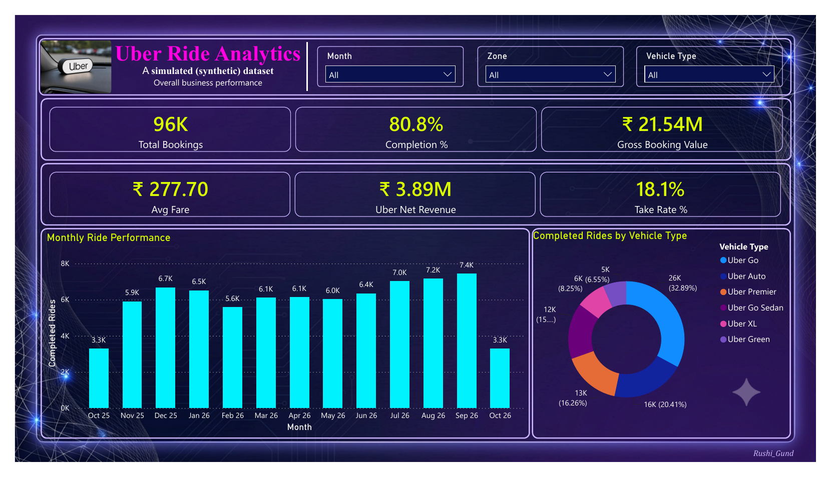
Uber Mumbai Ride Analytics
Cleaning, analysing and visualising 96K ride bookings with Excel, SQL and Power BI
Rushikesh Gund
linkedin.com/in/rushikesh-gund-89b8741ba
github.com/rushi0003
Notes:
Introduce yourself in one line. Mention that the dataset is synthetic because ride-level Uber data is not public, and that the workflow is the same as on real company data.

Slide 2
The project in 30 seconds
The problem
80.8%
An operations team wants to know where demand is, why rides fail, and what rain and festivals do to service.
Completion rate (77,530 of 95,983 bookings)
What I did
₹21.54M
Cleaned 96,055 booking rows, answered 16 questions in SQL, built Excel pivots and a 4-page Power BI dashboard.
Gross booking value (about ₹2.15 crore)
What I found
18.1%
About 1 in 5 requests fails, and the causes are fixable: heavy rain, very short trips and a few outer suburbs.
Uber take rate after driver payouts
Notes:
Use this slide as your elevator pitch. Problem, what you did, what you found. Then move on.

Slide 3
Five business questions guided the whole project
Each question was answered in at least one tool, so the numbers can be cross-checked.
Business question | Where I answered it | Tools
Where is demand concentrated? | Area pivot, Q5, map and zone flow | Excel, SQL, Power BI
Why do rides fail? | Q8, Q14, cancellation reasons page | SQL, Power BI
What does rain do to service? | Weather pivot, Q7, weather charts | Excel, SQL, Power BI
Are promos worth the cost? | Q10, promo table | SQL, Power BI
Which drivers and customers matter most? | Q11, Q12, customer segment chart | SQL, Power BI
I kept the scope simple on purpose: clear questions, clean data, honest numbers.
Notes:
Explain that you started from business questions, not from tools. Mention that every number was checked in more than one tool.

Slide 4
The dataset: one row per ride request
Success and failure are both recorded, so I could study demand and service quality together.
96,055
28
What each row holds
Booking, customer, driver and vehicle type
Pickup and drop area with coordinates
Distance, duration, wait time and weather
Fare, surge, toll, promo, discount and payment
Outcome: Completed, Cancelled by Rider, Cancelled by Driver or No Driver Found
Raw booking rows
Columns
48
12 months
Localities in 4 zones
15 Oct 2025 to 14 Oct 2026
Notes:
Describe the four possible outcomes of a booking. Say the mess in the data was deliberate so that cleaning could be practised.

Slide 5
Data cleaning: four steps, nothing hidden
Rule I followed: never edit the raw sheet and write down every change.
1
2
3
4
Inspect
Remove duplicates
Flag bad trips
Fill and log
Check duplicates, blanks, zero distances and odd speeds.
Keep one row per ride_id (earliest booking).
Completed rides with 0 km or speed under 4 km/h.
Blank weather / payment become "Unknown". Log all changes.
The check I used in Excel (column AC)
=IF(AND(W2="Completed",OR(L2=0,L2/(M2/60)<4)),"Bad","OK")
Notes:
Walk through the four steps in order. Mention the formula and the 4 km/h rule: a completed trip slower than walking speed means the trip never really ended.

Slide 6
Data quality log: what I found and what I did
Most issues were small, but a few would have quietly inflated the KPIs.
Issue | Rows affected | Action taken
Duplicate ride IDs | 55 (0.06%) | Removed, kept earliest booking
GPS glitch (distance = 0) | 10 | Flagged and excluded
Impossible speed (under 4 km/h) | 7 (₹6,650 fake fare) | Excluded: trip never ended
Missing weather | about 0.25% | Filled with "Unknown"
Missing payment method | about 0.3% | Filled "Unknown", skipped in payment trend
Missing latitude / longitude | about 0.4% | Kept for KPIs, no impact on totals
Customer rating blank | 32% of rides | Left blank: riders did not rate
Driver ID blank | No Driver Found rides | Valid by design, not an error
Notes:
Do not read the table line by line. Pick two rows: duplicates and impossible speed. Say the rest were handled the same way and are in the log.

Slide 7
Before and after: 96,055 rows became 95,983
72 rows removed, about 0.07% of the data. Small in count, big for trust.
96,055
− 55
− 17
95,983
Raw rows
Duplicates
Outliers (10 GPS + 7 speed)
Clean bookings
Why it matters
Fake fares from trips that never ended would inflate GBV
Double-counted rides would inflate bookings and completion rate
Every step is logged, so any number can be traced back
Excel, SQL and Power BI use the same logic, so all three match
Notes:
Key line: the same logic was applied in Excel, SQL and Power BI, so all three show the same totals.

Slide 8
Excel: helper columns, KPI sheet and pivots
I set the sheet up once so anyone on the team can pivot in minutes.
Helper columns: hour, weekday, month, time band, fare per km
Area type pulled from Area_Master with INDEX/MATCH
KPI sheet with COUNTIFS, SUMIFS and AVERAGEIFS
Pivots for weather, weekday x hour and payment mix (next slides)
What-if model for a short-trip driver bonus
A few formulas I used
Hour
=HOUR(B2)
Area type (lookup)
=INDEX(Area_Master!$E:$E,MATCH(G2,Area_Master!$A:$A,0))
Completed rides
=COUNTIFS(Rides[booking_status],"Completed")
Completion %
=Completed rides / Total bookings
Notes:
Mention one formula you are proud of, for example INDEX/MATCH to pull area type from Area_Master. The next three slides show the pivots.

Slide 9
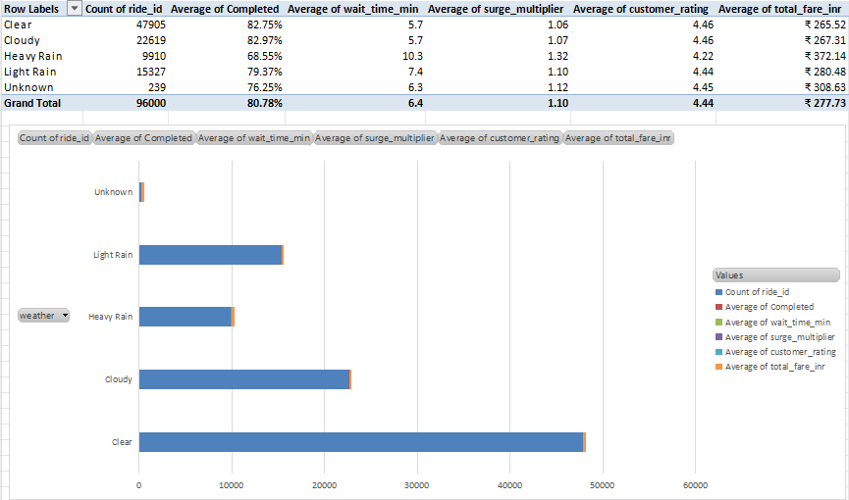
Excel pivot: heavy rain hurts every measure
Weather pivot
Heavy rain: 9,910 bookings (about 10% of volume)
Completion 68.55% vs 82.75% in clear weather
Wait time 10.3 vs 5.7 min
Surge 1.32 vs 1.06; rating 4.22 vs 4.46
Average fare ₹372 vs ₹266 in clear weather
Excel pivot on 96,000 de-duplicated bookings
So what: rain is the clearest case for a driver rain bonus and forecast-based positioning.
Notes:
Say this pivot was built before the 17 outlier rows were removed, so totals are 96,000, not 95,983. The conclusion does not change.

Slide 10
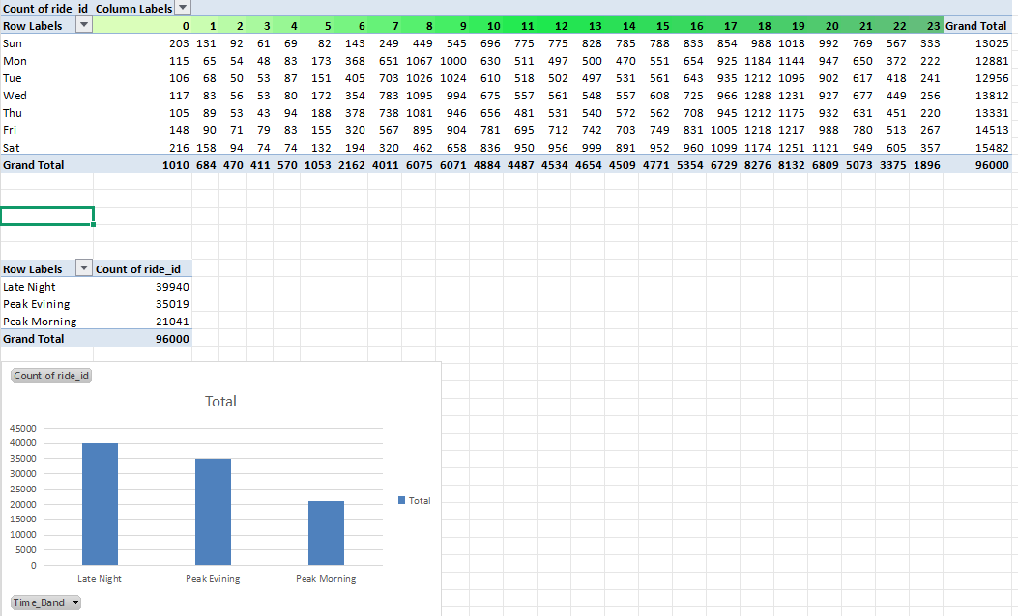
Excel heatmap: two weekday peaks, Saturday is busiest
Weekday x hour pivot
Weekday peaks at 8-9 am and 6-7 pm
Biggest single cell: Wednesday 6 pm (1,288 bookings)
Saturday is the busiest day (15,482); Monday the quietest (12,881)
Saturday evening stays high until about 8 pm
Excel pivot with colour scale (bookings by weekday and hour)
So what: schedule driver incentives and push notifications only in these peak slots.
Notes:
The colour scale makes the peaks visible at a glance. Point to the dark green cells.

Slide 11
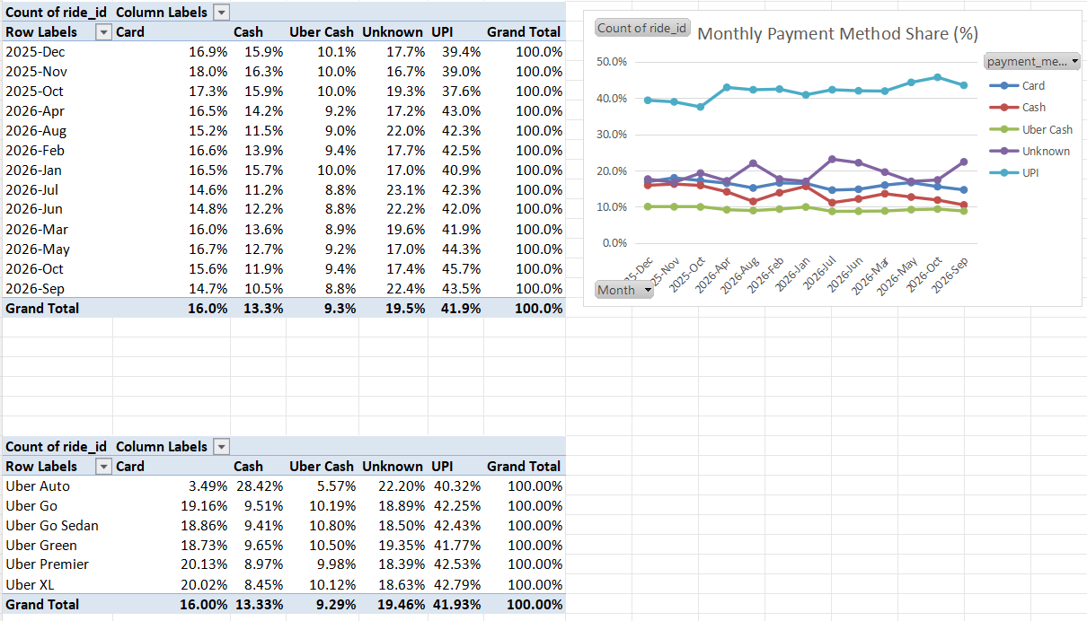
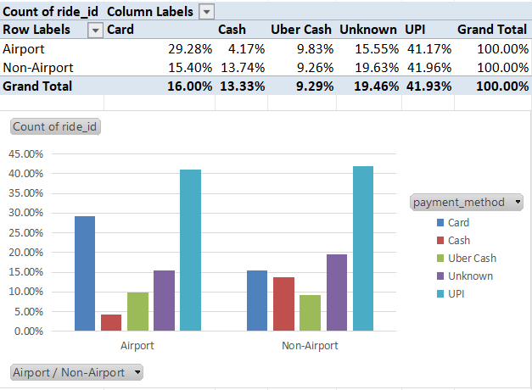
Excel pivot: UPI leads and cash keeps shrinking
Payment mix across all bookings, by month, vehicle type and airport vs non-airport.
Pivots: monthly payment mix and airport vs non-airport
UPI is 41.9% of bookings, up from 37.6% (Oct 25) to 45.7% (Oct 26)
Cash fell from 15.9% to 11.9%; Autos have the highest cash share (28.4%)
Airport rides: card 29.3% vs 15.4% elsewhere, cash only 4.2%
Unknown (19.5%) is close to the failed-booking share, since failed rides have no payment
Notes:
Unknown payment is mostly failed bookings, because a cancelled ride never reaches payment. Mention that clearly if asked.

Slide 12
SQL: one clean view, 16 questions answered
Every query reads from rides_clean, so there is a single source of truth.
Q2: the clean view
Q8: why drivers cancel
CREATE VIEW rides_clean AS
SELECT * FROM (
SELECT r.*, ROW_NUMBER() OVER (
PARTITION BY ride_id
ORDER BY booking_datetime) AS rn
FROM uber_mumbai_rides r) t
WHERE rn = 1
AND (booking_status <> 'Completed'
OR (distance_km > 0 AND
distance_km/(trip_duration_min/60.0) >= 4));
SELECT CASE
WHEN distance_km < 2.5 THEN 'Under 2.5 km'
WHEN distance_km < 8 THEN '2.5 - 8 km'
WHEN distance_km < 18 THEN '8 - 18 km'
ELSE 'Above 18 km' END AS bucket,
COUNT(*) AS bookings,
ROUND(100.0 * SUM(CASE WHEN
booking_status = 'Cancelled by Driver'
THEN 1 ELSE 0 END) / COUNT(*), 1)
AS driver_cancel_pct
FROM rides_clean GROUP BY 1 ORDER BY 1;
CTEs and window functions: ROW_NUMBER, LAG, RANK, NTILE
Topics: KPIs, growth, areas, hours, weather, cancellations, promos, drivers, customers, routes
Anomaly rule: a day with a no-driver rate above 12%
Notes:
Explain ROW_NUMBER: partition by ride_id, keep row 1. Then explain the CASE bucket query. Mention the other window functions you used: LAG, RANK and NTILE.

Slide 13
Dashboard page 1: the business is growing
Completed rides rose about 26% from November to September.
Completed rides: 5.9K in Nov to 7.4K in Sep
Oct 25 and Oct 26 are partial months, so I ignore them
Go and Auto are over half of all rides (32.9% + 20.4%)
XL and Premier are only 25% of rides but about 35% of fare value
Page 1: Executive overview
Take rate is 18.1%, so for every ₹100 a rider pays, Uber keeps about ₹18.
Notes:
Point to the monthly bars. Say October 2025 and October 2026 are partial months, so you ignore them for growth.

Slide 14
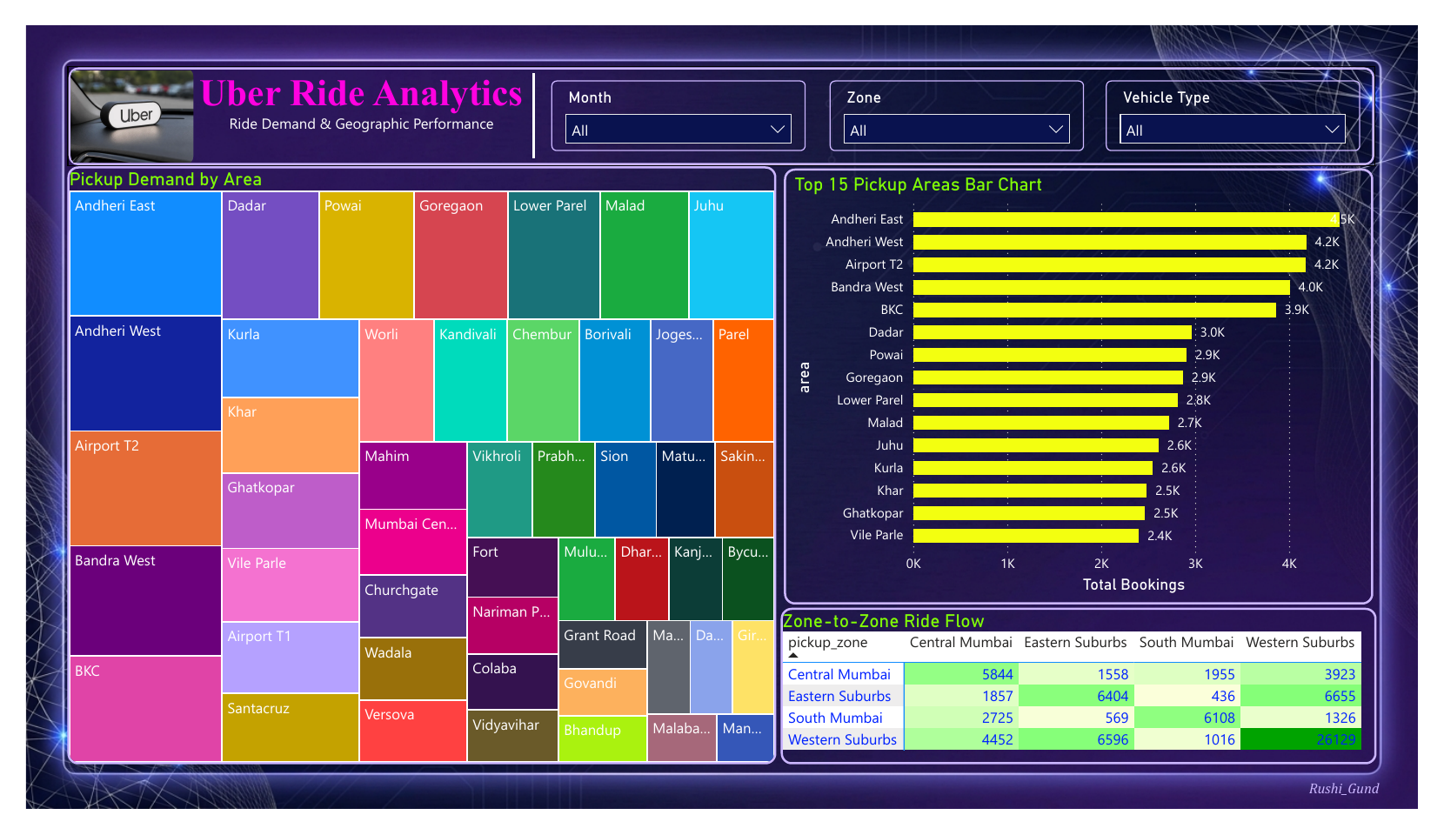
Dashboard page 2: demand sits in the Western Suburbs
Where riders start matters more than where they end.
Western Suburbs: 49% of completed rides. South Mumbai: 14%
26,129 rides start and end inside the Western Suburbs
Eastern ↔ Western is the biggest cross-zone flow (about 6,600 each way)
Outer areas (Govandi, Mankhurd, Kandivali, Mulund) wait 7.7 to 8.1 min vs 6.2 city average
Page 2: Ride demand and geography
So what: move driver incentives to long-wait areas before adding new drivers.
Notes:
Zone matrix: read the diagonal. Western to Western is the huge number. Then mention the east-west office corridor.

Slide 15
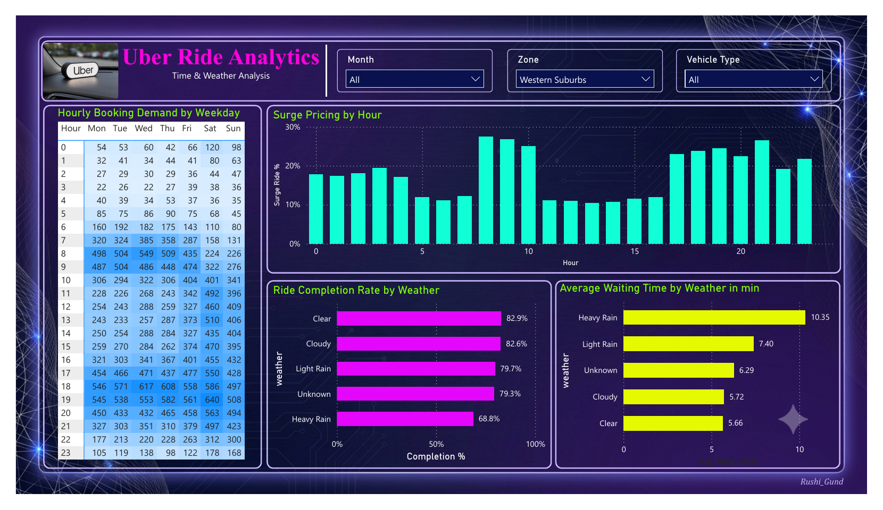
Dashboard page 3: peaks and rain break the service
Two weekday peaks, and heavy rain hurts on every measure.
Weekday peaks: 8-10 am and 5-8 pm (52% of weekday bookings)
Surge hits about 25% of rides at peaks vs about 11% at midday
Heavy rain city-wide: completion 68.5% vs 82.7% clear
Wait 10.3 vs 5.7 min; no-driver cases 10.2% vs 3.3%
Page 3: Time and weather (filter: Western Suburbs)
So what: time-bound peak incentives and a rain-readiness plan cost far less than all-day offers.
Notes:
This page is filtered to Western Suburbs. City-wide figures are on the right. Say that clearly if asked about a mismatch.

Slide 16
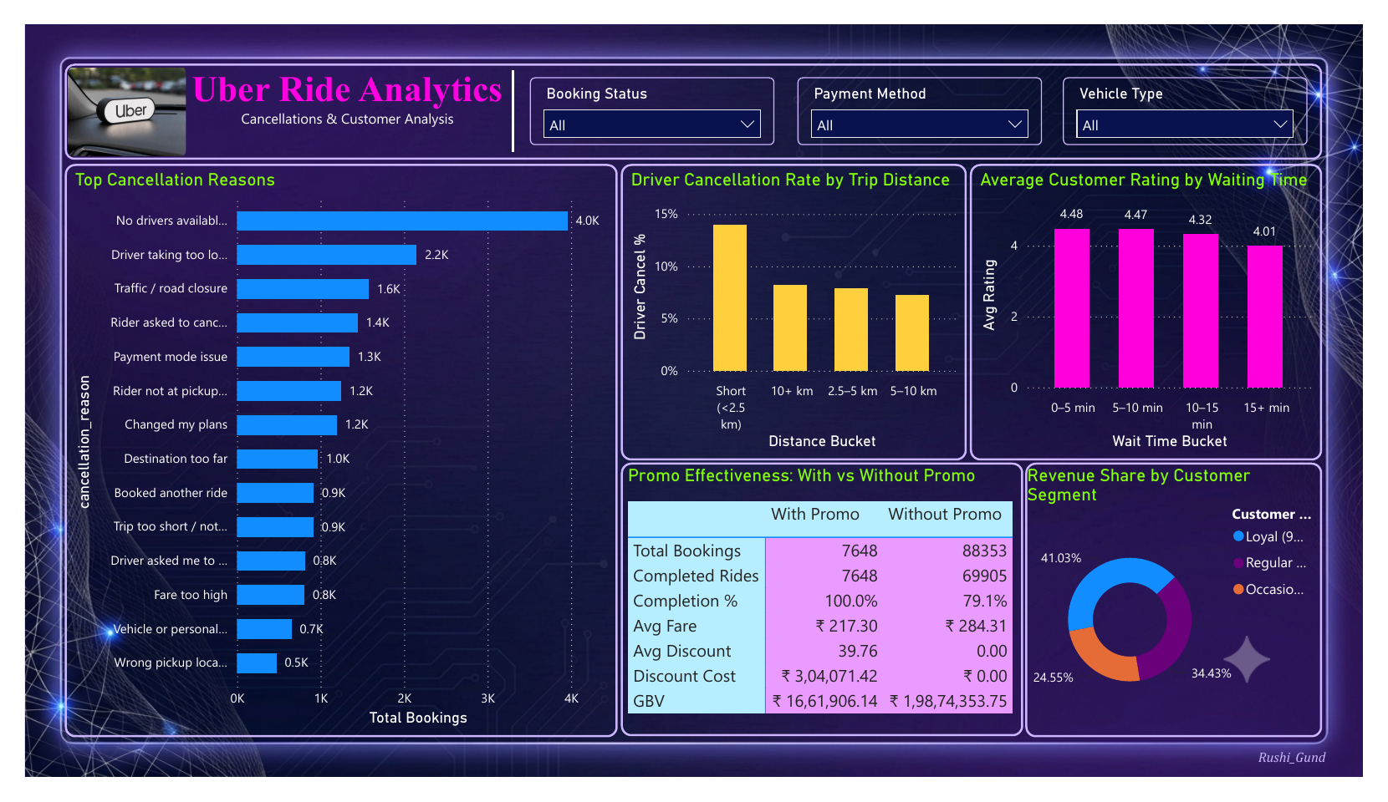
Dashboard page 4: why rides fail and who matters
Drivers cancel when the trip does not feel worth it, and riders punish long waits.
Top failure reason: no drivers available (4.0K), then driver taking too long (2.2K)
Drivers cancel 14.0% of trips under 2.5 km vs 7.5% on normal trips
Rating drops from 4.48 (short wait) to 4.01 (15+ min wait)
Loyal customers (9+ rides) bring 41% of revenue
Page 4: Cancellations and customers
So what: fix supply at peak and rain first; then reward short trips and loyal riders.
Notes:
Link wait time to rating: a long wait lowers rating, which is why no-driver and slow pickup matter commercially.

Slide 17
A promo number that looks too good, and why I questioned it
Promo rides show 100% completion. That is not proof that promos work.
9.9%
₹3.04 lakh
₹217 vs ₹284
of completed rides use a promo
total discount, about 1.4% of gross fare
average fare with vs without promo
What I concluded
What I would do next
Promo is logged only on completed rides, so 100% completion is a data artefact
Promo rides are smaller trips, so promos attract low-value rides
Promos are cheap, so the risk is low, but the benefit is not proven
Limit promos to off-peak hours and first rides
Run an A/B test with a control group
Notes:
This slide shows critical thinking. Promo is only recorded on completed rides, so 100% is built into the data.

Slide 18
Recommendations and estimated impact
Estimates are scenario numbers on this sample. I would confirm each one with an A/B test.
Problem | Evidence | Action | Est. impact
Heavy rain | Completion 68.5% vs 82.7% | Rain bonus, pre-position drivers | ~339 rides, ₹1.26 lakh
Short trips | Driver cancels 14.0% vs 7.5% | Short-trip bonus or minimum fare | ~663 rides, ₹0.67 lakh
Outer suburbs | Driver cancels 11.9% vs 8.5% | Return-trip incentive | ~256 rides, ₹0.71 lakh
Failure days | 5 days above 12% no-driver | No-driver alert at 12% | ~377 bookings, ₹1.05 lakh
Peak hours | 52% of weekday demand | Incentives in peak slots only | Lower incentive spend
Total scenario recovery: about ₹3.7 lakh GBV a year on the sample.
Notes:
Be ready to explain one assumption per row, for example halving the extra no-driver gap in rain.

Slide 19
What I learned and what I would improve
What I learned
Limits and next steps
Validate data first; it changed my KPIs
One clean logic keeps Excel, SQL and Power BI matching
Every insight needs a so-what and a rupee value
Question numbers that look too good (promo 100%)
Data is synthetic, so impact is an estimate
Test incentives with A/B experiments
Add driver profitability and demand forecasting
Automate refresh and alerts in Power BI Service
Tools: Excel (formulas, pivots, what-if) | SQL (CTEs, window functions) | Power BI (star schema, DAX)
Notes:
Finish with honesty: limits of synthetic data, and a concrete next step. Interviewers like this.

Slide 20

Thank you
Rushikesh Gund
linkedin.com/in/rushikesh-gund-89b8741ba
github.com/rushi0003

